Slide 1

A Deep learning approach to Identify surface crack

Slide 2
presented By
supervised By
ABU TAREK RABBI - 180104086
ISHFAQ RAHMAN - 180104093
CHOWDHURY SALMAN - 180104095
TAHLAMUNA RULPI - 170204083
MD. TANVIR ROUF SHAWON
NIBIR CHANDRA MANDAL

Slide 3
INTRODUCTION
Crack plays a critical role in evaluating the quality of concrete structures, which affects the structure's safety, applicability, and durability
Detection of the crack in surfaces, roads, buildings, etc.
Using deep learning methods to build a simple yet very accurate model for crack detection
Manual inspection of crack detection can be challenging & consumes Time.

Slide 4
Objective
Monitor structural health and ensure structural safety.
Extracting features when image processing techniques detect cracks in an image.
Time-consuming & challenging manual inspection of crack detection will be replaced in the case of high-rise buildings and bridges.
Test the model on real-world data and see that the model is accurate in detecting surface cracks in concrete and non-concrete structures, for example, roads, buildings, etc.

Slide 5
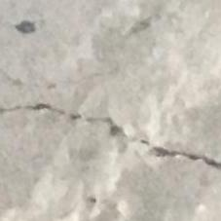
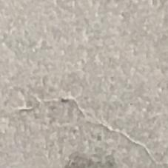
Dataset
In this project, we use 40,000 photos of the dataset, and the number of cracks and non-crack images is set to equal.
20,000 images of concrete structures with cracks
20,000 images of concrete structures without cracks.
Examples:
Fig: Positive Crack
Fig: Negative Crack

Slide 6
Literature review
Paper Title: Deeper Networks for Pavement Crack Detection
For Pavement Crack Detection using Convolutional neural networks
Pooling layer, Activation layers, Softmax layer were used
The experimental evaluations were performed on two different hardware settings- one for training the network and the other for testing the network performance.

Slide 7
Literature review
Paper Title: Road crack detection using deep convolutional neural network
Deep learning, convolution neural networks for road crack detection, road survey.
ConvNet Architecture is used which is considered as a hierarchical feature extractor.
The ConvNets are trained using the stochastic gradient descent (SGD) method.

Slide 8
Literature review
Paper Title: Automatic Bridge Crack Detection Using a Convolutional Neural Network
image classification for bridge crack detection by deep learning
CNN trained end-to-end with images to detect cracks, using only images and image labels as input
The Atrous Spatial Pyramid Pooling (ASPP) module into the field of crack detection for the first time, and achieved good experimental results

Slide 9
Literature review
Paper Title: Crack and Noncrack Classification from Concrete Surface Images Using Machine Learning
To construct the classification models, SURF and CNN features are obtained from the CCRs
Robust classification model can be constructed from the CCRs.
The trained classification models of the SURF-based and CNN-based methods are compared to quantitatively evaluate the identification performances.

Slide 10
Collecting crack images
GENERAL SYSTEM ARCHITECTURE
Data Pre-Processing
Data Transformation
Feature Extraction
Logistic Regression Model
Implementation
CNN model Implementation
DNN model Implementation
Train The Model
Find Accuracy

Slide 11
Proposed Methodology
MODELS
Activation Functions
DNN (single layer & leakrelu)
DNN (multiple layer & Relu)
DNN (multiple layer & leakrelu)
Logistic Regression
Convolutional Neural Network (CNN)
Relu
Leaky Relu
SoftMax

Slide 12
Background Study
Step-1: Data Loading
A batch of data is randomly loaded from the training set (batch size: 20) for subsequent data processing.
Step-2: Data Pre-processing:
Data augmentation via resizing, translation, and other operations.
Step-3: Define the structure of the crack detection model
Leaky ReLU is used for DNN, SoftMax is used in Logistic Regression, and ReLU is used for CNN.
Step-4: Compile the model and start training
Compile the models of CNN, DNN, and Logistic Regression and then train the models randomly shuffled before each epoch

Slide 13
Result Analysis
Model Name | Accuracy (in %) | Loss
DNN (single layer & leakrelu) | 79.22 | 0.458281
DNN (multiple layer & Relu) | 49.08 | 0.6835
DNN (multiple layer & leakrelu) | 82.64 | 0.7105
Logistic (SoftMax) | 87.46 | 0.41800
Convolutional Neural Network (Relu) | 98.33 | 0.06472

Slide 14
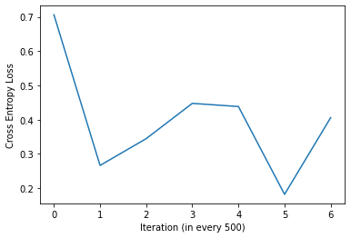
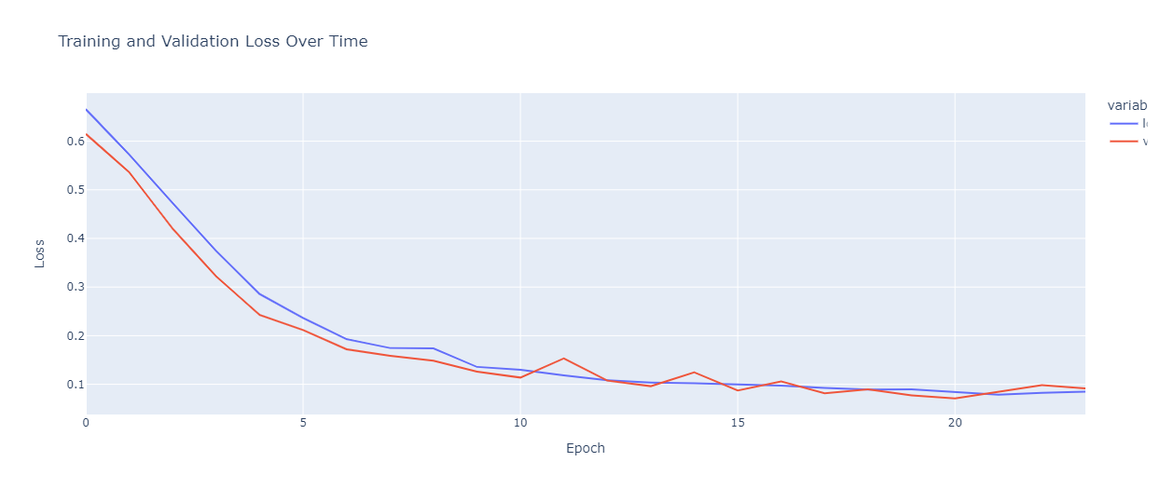
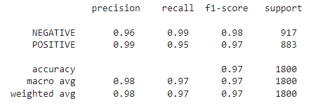
DNN (SINGLE LAYER)
LOGISTIC REGRESSION MODEL
CONVOLUTIONAL NEURAL NETWORK MODEL

Slide 15
Conclusion
In this study, we tried to explore the opportunity to detect the surface crack with the help of a deep
learning methods.
The research approach of this paper can be adopted in various types of damage detections such as the scaling of the concrete surface, piles of bridges, peeling paint of steel and concrete, and so on.
In future studies, more images with more types of concrete damages under various conditions will be provided and added to the database to increase the adaptation and robustness of the proposed method, and comparative studies will also be performed.

Slide 16
References
Leo Paulya, Harriet Peela, Shan Luoa, David Hoggb and Raul Fuentesa "Deeper Networks for Pavement Crack Detection"
Q. Zhu, T. H. Dinh, V. T. Hoang, M. D. Phung, Q. P. Ha "Crack Detection Using Enhanced Thresholding on UAV based Collected Images"
Hongyan Xu, Xiu Su, Yi Wang , Huaiyu Cai, Kerang Cui and Xiaodong Chen "Automatic Bridge Crack Detection Using a Convolutional Neural Network"
Daniel Weimer a,c, Bernd Scholz-Reiter (1)b, *, Moshe Shpitalni (1)c "Design of deep convolutional neural network architectures for automated feature extraction in industrial inspection"
Hyunjun Kim, Eunjong Ahn, Myoungsu Shin and Sung-Han Sim "Crack and Noncrack Classification from Concrete Surface Images Using Machine Learning"
Lei Zhang, Fan Yang, Yimin Daniel Zhang, and Ying Julie Zhu "ROAD CRACK DETECTION USING DEEP CONVOLUTIONAL NEURAL NETWORK“
Dataset : https://www.kaggle.com/datasets/arunrk7/surface-crack-detection?fbclid=IwAR3lsAapE5wmdMU0u0P0szC9AtydIJeh6BGotn8f62POcb7cJyxXqSMt2LM

Slide 17
Thank you

